Slide 1


Introduction to
Robotic Process Automation
LIBRARY MANAGEMENT BOT
Register No: 220701078
Name: Guhanraj . P
Guide Name: Mrs. J. Jinu Sophia(Ph.D.)
Designation: Assistant Professor(SG)
Department: Computer Science and Engineering

Slide 2
Abstract
This project presents an innovative automation solution using UiPath Robotic Process Automation (RPA) to streamline library membership management and book searching. It automates member registration by capturing essential details such as name, phone number, address, and email, validating them through OTP-based verification, and securely storing the data in an Excel database while sending a welcome email. The book search functionality allows users to locate books by inputting their names, cross-referencing them with an Excel inventory, and retrieving precise location details, which are emailed to the user. Leveraging UiPath advanced features, including Input Dialog, Excel Application Scope, and SMTP Mail activities, the workflow ensures robust error handling, secure data processing, and seamless execution. This automation significantly reduces administrative effort, enhances user experience, and offers a scalable framework applicable to other domains.

Slide 3
Need for the Proposed System
Efficiency: Manual processes, such as library management, membership registration, or license applications, are time-consuming and prone to errors. Automation significantly reduces the time required.
Accuracy:Automation ensures accurate data handling, reducing errors in tasks like data entry, validation, and verification.
Scalability:As the demand increases (e.g., more applicants or members), automation can handle larger workloads without additional manpower.
Consistency:The system performs repetitive tasks in the same way every time, ensuring uniformity and reliability in results.
Integration:It bridges gaps between various systems, such as Excel files, databases, web applications, and email systems, enabling seamless workflows.
Cost Reduction:By automating routine tasks, organizations save on labor costs and minimize rework caused by human errors.

Slide 4
Advantages of the Proposed System
Time-Saving:Processes like OTP verification, data storage, and message sending are completed in seconds rather than minutes or hours.
Improved User Experience:Tasks such as sending automated welcome messages or verifying data in real-time improve user satisfaction and trust.
Real-Time Processing:Immediate validation and processing of information ensure quicker turnaround times, e.g., in driving license applications.
Security:Automated OTP verifications enhance data security by ensuring that only valid users proceed in the process.
Customizable and Scalable:UiPath workflows can be tailored to meet specific requirements and scaled as organizational needs grow.
Error Reduction:By eliminating manual intervention, errors in data entry, calculations, and processing are significantly reduced.

Slide 5
Literature Survey
1. Paper Title:"Enhancing Efficiency in Library Management Robotic Process Automation”
Advantages:
  Automation reduces human effort in task like book inventory management.
  Enhances user experience by providing instant updates on book availability.
Disadvantages:
  Challenges in handling unstructured or handwritten data.
  Requires periodic maintenance and updates to workflows.
2. Paper Title:"Scalability of RPA in Library Management System.”
Advantages:
  Supports high-volume processes, such as managing thousands of book records.
  Logs and tracks all operations for auditing and monitoring purposes.
Disadvantages:
  Lack of flexibility in handling sudden changes in operational processes.
  High reliance on IT specialists to manage and troubleshoot the system.

Slide 6
Main Objective
The primary objective of this project is to develop an automated Library Management System using Robotic Process Automation (RPA) with UiPath to simplify and streamline the core processes involved in managing library operations. This includes automating tasks such as registering new members, managing book inventories, searching for books, tracking book locations, and issuing or returning books. By leveraging automation, the system aims to eliminate manual errors, reduce processing time, and enhance operational efficiency, ensuring that both library staff and users benefit from a seamless and user-friendly experience. The project also integrates features such as data storage in Excel, real-time updates, and automated notifications to improve transparency and accessibility. This scalable and reliable solution minimizes human intervention, reduces administrative workload, and supports libraries in managing larger inventories or user bases effectively while maintaining accuracy and consistency in data handling.

Slide 7
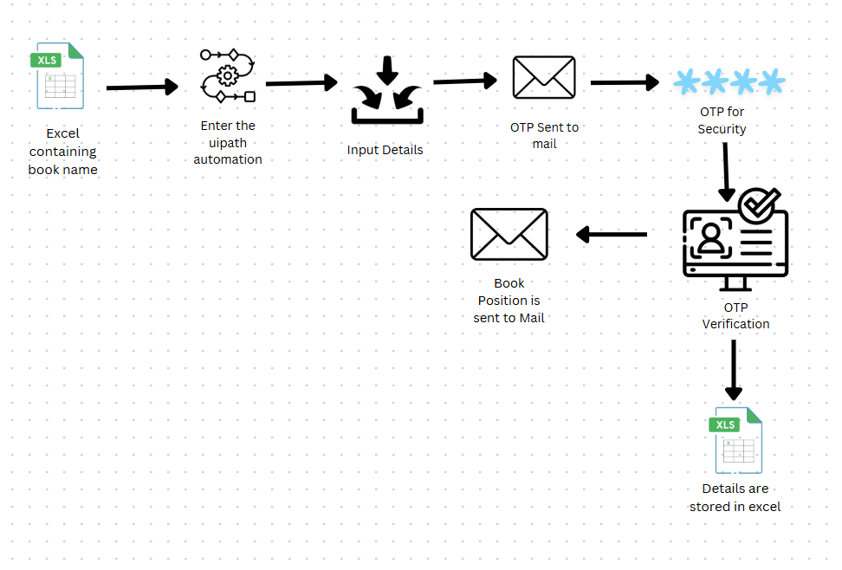
Architecture
.

Slide 8
System Requirements
Hardware
Processor: Minimum of Intel Core i3 or higher version for faster processing.
RAM: Minimum of 4 GB or higher to handle ensure smooth execution.
Storage:Minimum: 20 GB free space for quicker application and data handling.
Network:Stable internet connection for cloud resources, email , and OTP verification.
Software
Operating System:Minimum: Windows 10 (64-bit) or higher.
RPA Software:UiPath Studio and UiPath Robot for workflow execution.
Database/Storage:Microsoft Excel (for small to medium datasets).
Web Browser:Google Chrome, Microsoft Edge, or Mozilla Firefox.

Slide 9
Table Design
1. Book Details Table
This table stores information about the books in the library system. It includes the book’s name, as well as its specific location within the library, which is divided into cupboard, row, and position. This allows the automation to efficiently locate any book based on the name entered or retrieved from an input source, ensuring that the book's exact position is easily identified for subsequent actions.
2. Member Details Table
This table contains personal information for each library member, such as their name, phone number, email address, and physical address. This data is essential for tasks like verifying member details, sending notifications, or processing membership-related actions. The table ensures that member data is structured and accessible for automated processes, such as OTP verification or communication.

Slide 10
Process Design
Input Data Collection:The process begins by reading the input data, such as book details or member information, from an Excel file. This is achieved using the Excel Application Scope and Read Range activities in UiPath.Data Processing and Validation:Once the data is collected, it is iterated through row by row using the For Each Row activity. During this stage, inputs are validated using If conditions.Task Automation:In this stage, the automation dynamically performs tasks based on the processed data. For a library system, it searches for books and identifies their location (e.g., cupboard, row, and position). This is done through a Message Box or by sending an email using the Send SMTP Mail Message activity.Output and Reporting:Processed data, such as book locations, new member records, or form submission statuses, is written back into an Excel file using the Write Range activity. Error Handling and Logging:To make the workflow robust, critical sections are enclosed within a Try Catch block to handle exceptions gracefully. For example, it can handle issues like missing files or application errors without interrupting the entire process.

Slide 11
Implementation
Data Retrieval:Uses Excel Application Scope and Read Range to fetch input data (e.g., book details, member details) from an Excel file and store it in a DataTable.
Task Execution:Implements a For Each Row loop to process the data row by row.Performs automated actions like searching for books, filling forms, and validating inputs using activities such as Type Into, Click, If, and Assign.
Validation and Notifications:Validates user inputs or system outputs (e.g., verifying book locations or application details).Sends feedback or confirmation using Message Box or Send SMTP Mail Message activities.
Output and Reporting:Writes processed data or results back into an Excel file using Write Range.Generates basic reports or summaries of actions performed.

Slide 12
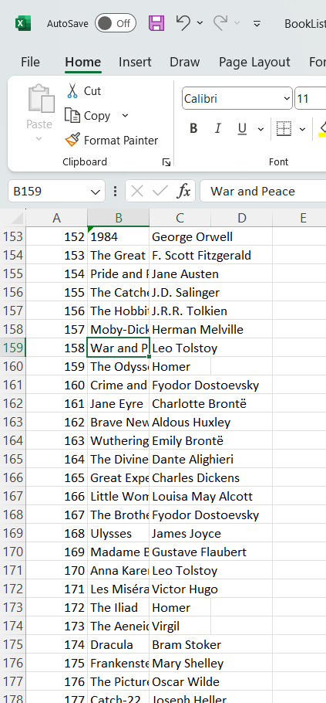
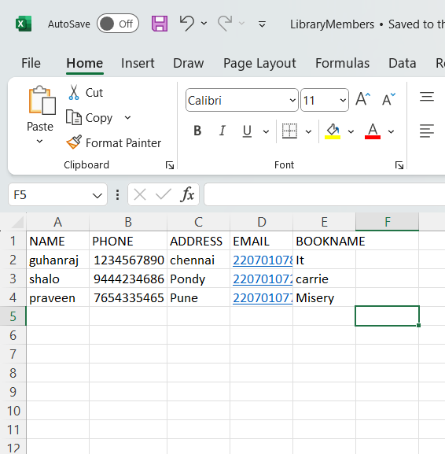
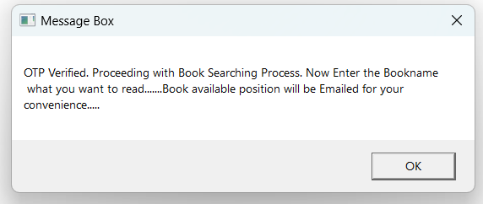
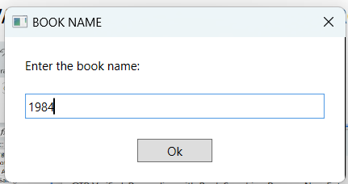
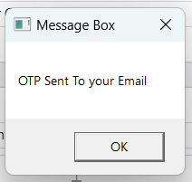
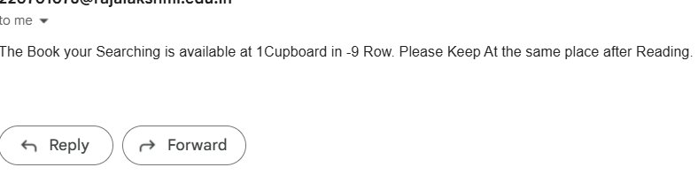
Testing
BOOKS AVAILABLE AFTER STORING PROCESS TESTING

Slide 13
Conclusions
The Library Management Bot developed using UiPath successfully automates the process of locating books within a library system. By leveraging UiPath’s capabilities, the bot reads an input Excel file containing book details and categorizes books into different cupboards based on their serial number. This reduces the time required to find a specific book and improves the efficiency of library management. The bot's user interaction module allows users to easily search for books by name, returning the cupboard and row location where the book is stored. Future enhancements could include integrating a database to handle dynamic updates and expanding the bot’s functionality to manage book checkouts and returns.

Slide 14
Future Enhancement
1.Integration with Database to handle large volumes of data efficiently. This can improve data security, scalability, and performance.
2.Enhanced Error Handling to Customize error messages for specific exceptions and automatic retries for temporary failures.
3.Input data directly without editing Excel files and view results in a user-friendly format.
4.To Enable notifications or alerts to be sent via mobile apps for real-time updates on task completion or exceptions.
5.Validate user data Phone numbers, emails using external services.
6.AI-Powered Enhancements to integrate AI and Machine Learning capabilities for predictive analytics (e.g., predicting peak library usage or identifying popular books).
7.Enable voice input or output using UiPath's integration with tools like Google Assistant or Alexa for a hands-free user experience.

Slide 15
References
1. RPA and UiPath Documentation: - UiPath Official Documentation. Retrieved from [https://docs.uipath.com](https://docs.uipath.com)
2. UiPath Academy Courses. Retrieved from [https://academy.uipath.com](https://academy.uipath.com)
3. Excel Automation in UiPath: - Automating Excel Processes. Retrieved from [https://docs.uipath.com/activities/docs/excel.automation](https://docs.uipath.com/activities/docs/excel-automation)
4. UiPath Forum Discussions on Excel Automation. Retrieved from [https://forum.uipath.com](https://forum.uipath.com)

Slide 16
Queries

Slide 17
Demonstration

Slide 18
Thank You

